Slide 1
Roomvo Usage and Customer Engagement Analysis
Ivan Hladkyi
Published Analysis Link

Slide 2
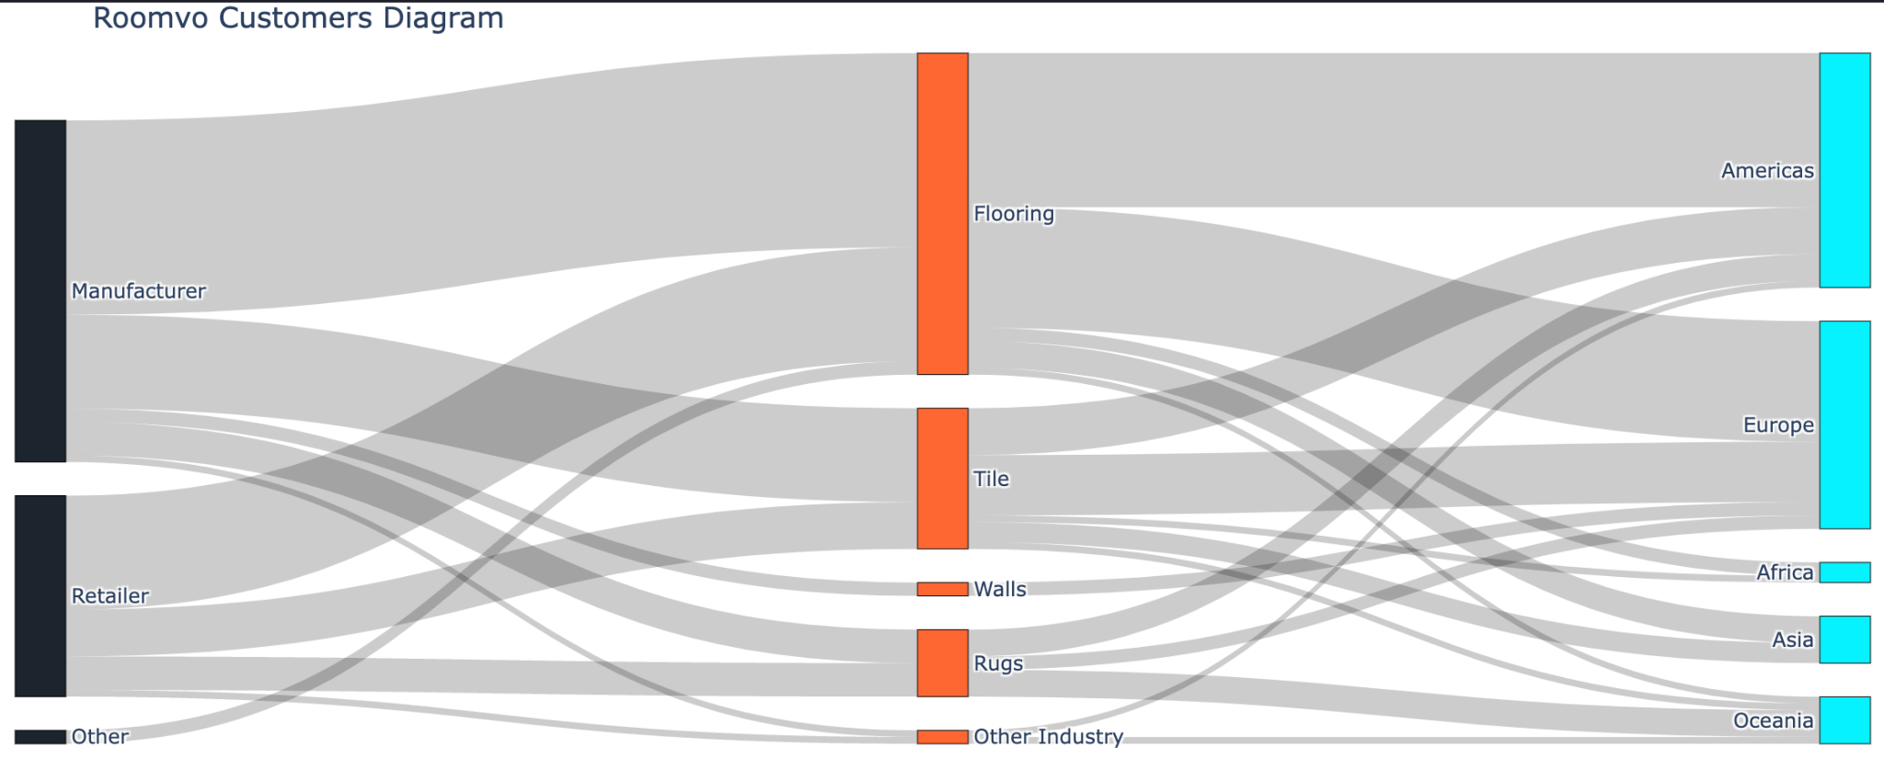
Roomvo Usage and Customer Engagement Analysis
1. Data Exploration and Descriptive Analysis
Manufacturer is a dominant type of customer & Retailer takes the second place,
Customers-Metrics dataset contained empty values that were filled with zeroes,
High variance in columns num_sessions, num_product_views, and total_time_spent_in_seconds,
Flooring and Rugs industries have the highest number of anomalies, Oceania and the Americas show a higher tendency for anomalous session counts.

Slide 3
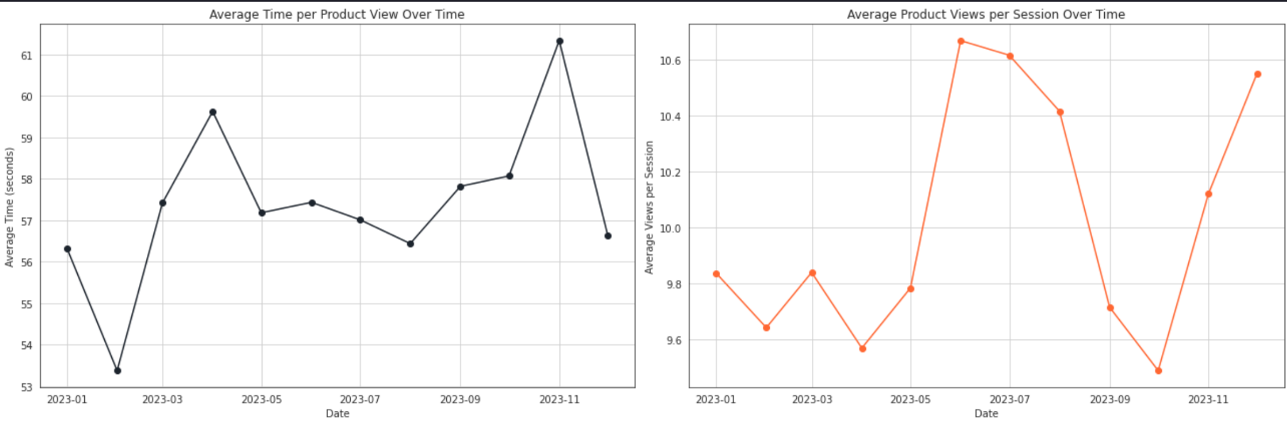
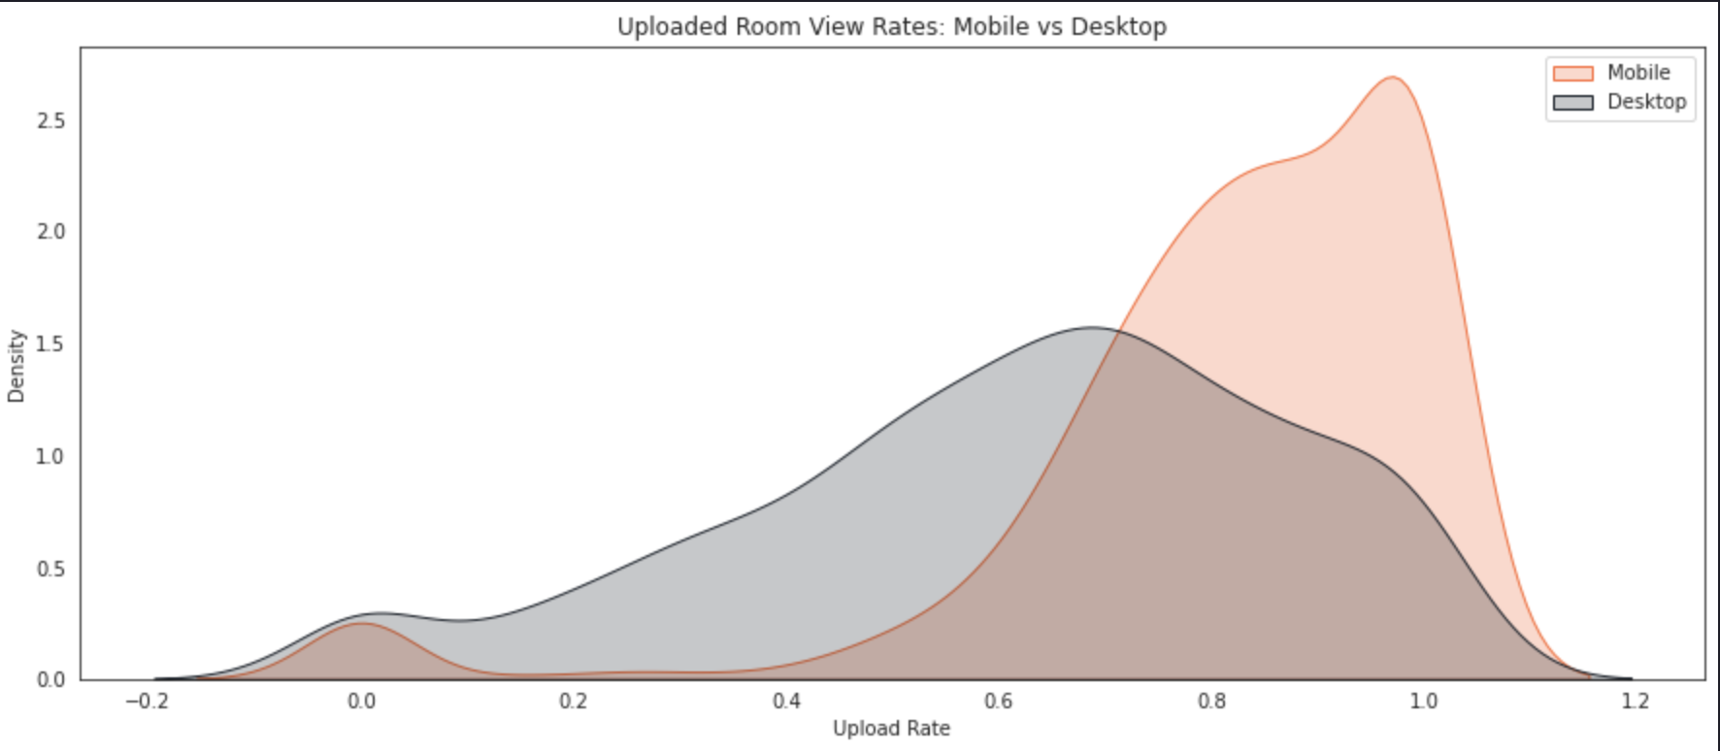
Roomvo Usage and Customer Engagement Analysis
2. Product Performance Analysis
New KPIs proposed:
Repeat Usage Rate
Daily Active Users (DAU) to Monthly Active Users (MAU) Ratio
Discovered that Average time spent per product view & Average number of product views per session have weak negative correlation.
Compared mobile to desktop room upload rates. Discovered that mobile segment has significantly higher upload rates.

Slide 4
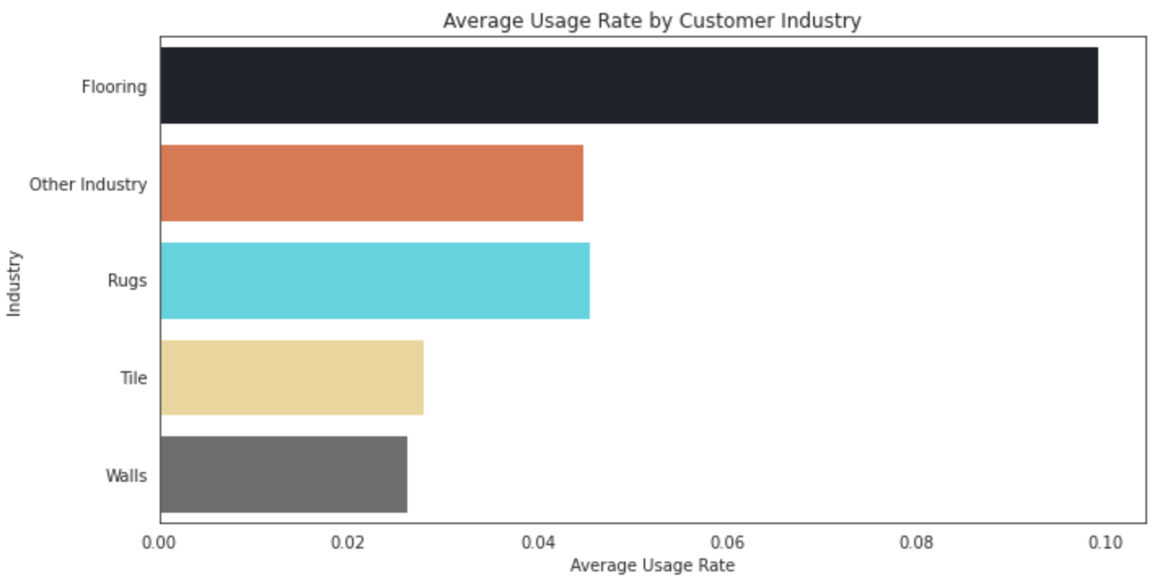
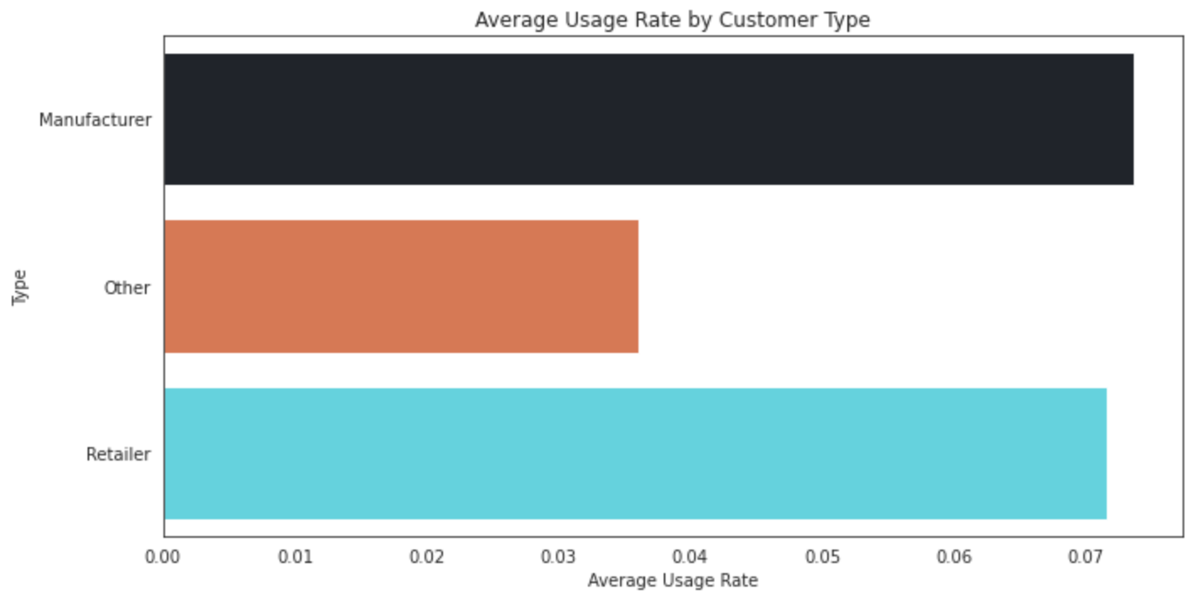
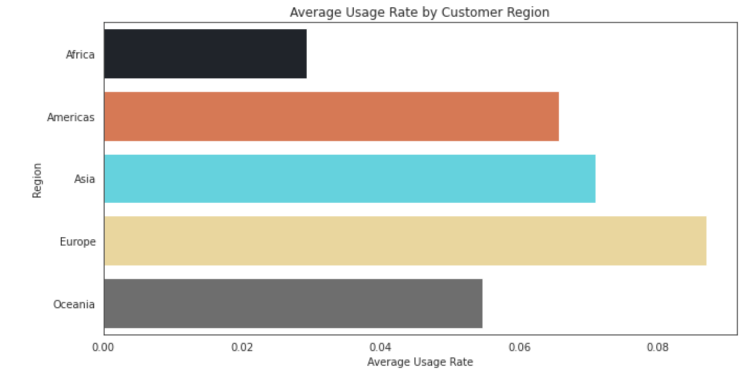
Roomvo Usage and Customer Engagement Analysis
3. Customer Insights
Flooring industry exhibits notably higher usage, suggesting greater relevance or better fit of the Roomvo app for this industry,
Manufacturers and Retailers show similar average usage rates, significantly higher than 'Other' type,
Europe leads in usage rate among regions, with Africa showing the lowest average usage.

Slide 5
Roomvo Usage and Customer Engagement Analysis
4. Recommendations and Insights
Target High-Engagement Industries and Regions
Focus marketing and sales efforts on industries with higher usage rates, particularly the Flooring industry,
Prioritize regions like Europe and Asia, where usage rates are higher, for expansion or targeted campaigns.
Improve Engagement in Low-Usage Demographics
Investigate reasons for lower usage rates in industries like Tile and Walls and regions like Africa,
Develop tailored strategies or features to increase adoption and engagement in these areas.
Leverage Mobile Platform Strengths
With mobile users showing a higher rate of uploading their own room images, enhance mobile app features to capitalize on this behaviour.
Customize Approach Based on Customer Type
Recognize the different usage patterns between Manufacturers, Retailers and Other customer types,
Develop specific strategies or features that cater to the unique needs of each customer type.

